Slide 1
Understanding and Managing Notifications
Swadhin Pradhan¹, Lili Qiu¹, Abhinav Parate², and Kyu-Han Kim³.
¹UT Austin ²Lumme Inc. ³Hewlett-Packard Laboratories
Notes:
Good afternoon everyone ☺ Thank you for the introduction .. If any.. I will be presenting our paper titled Understanding and .. Which is a joint work with my advisor Lili and Abhinav from Lumme and Kyu-Han from Hewlett Packard Laboratories.
Important points to mention :
Better transition into different parts.

Slide 2
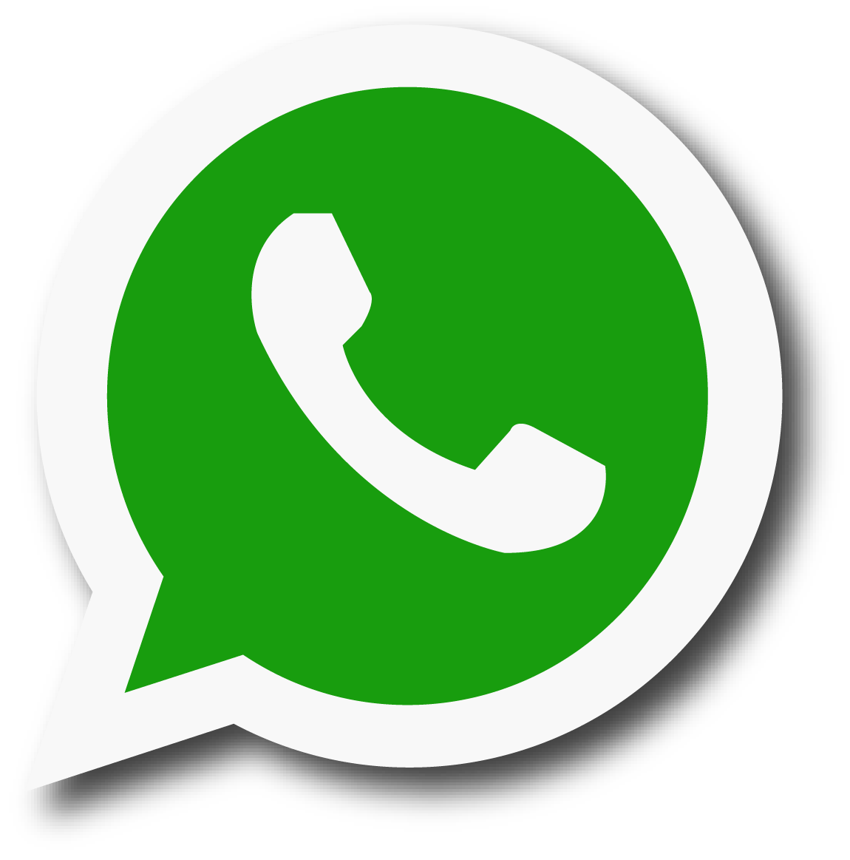


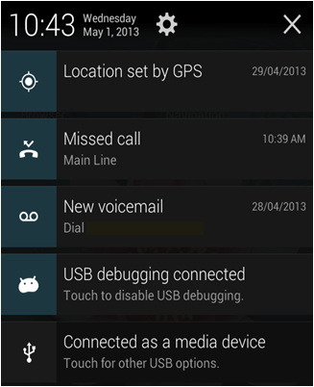
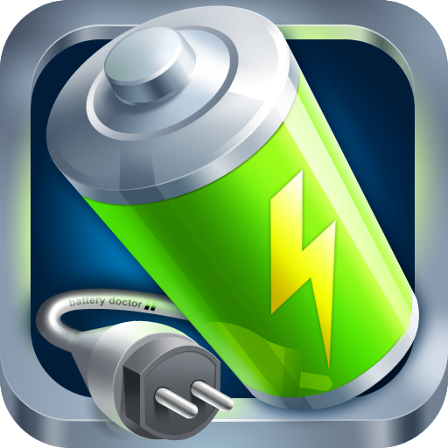











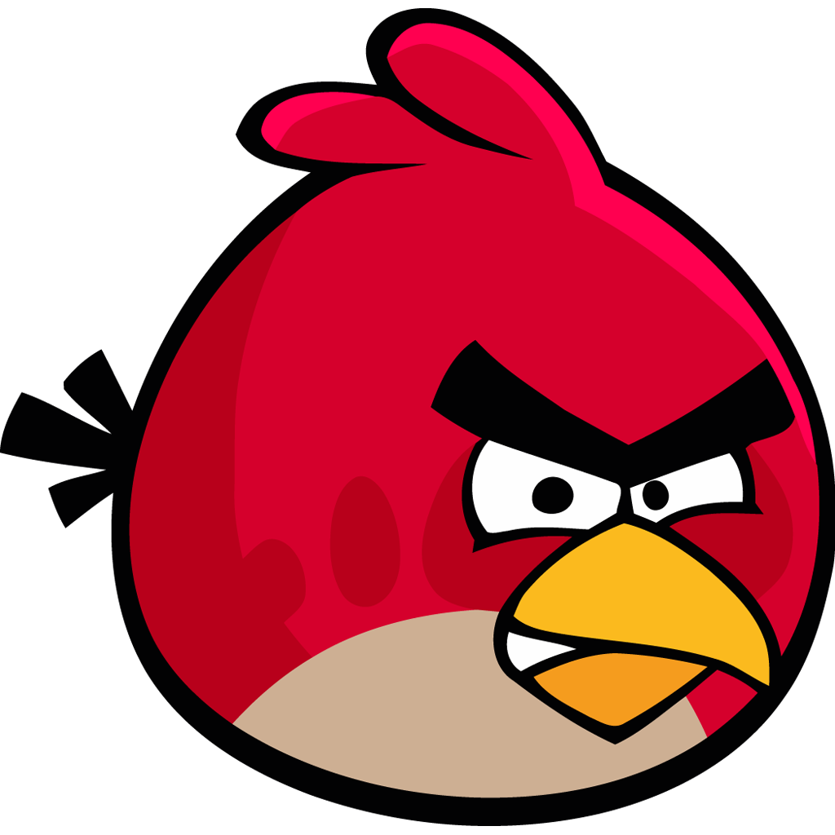


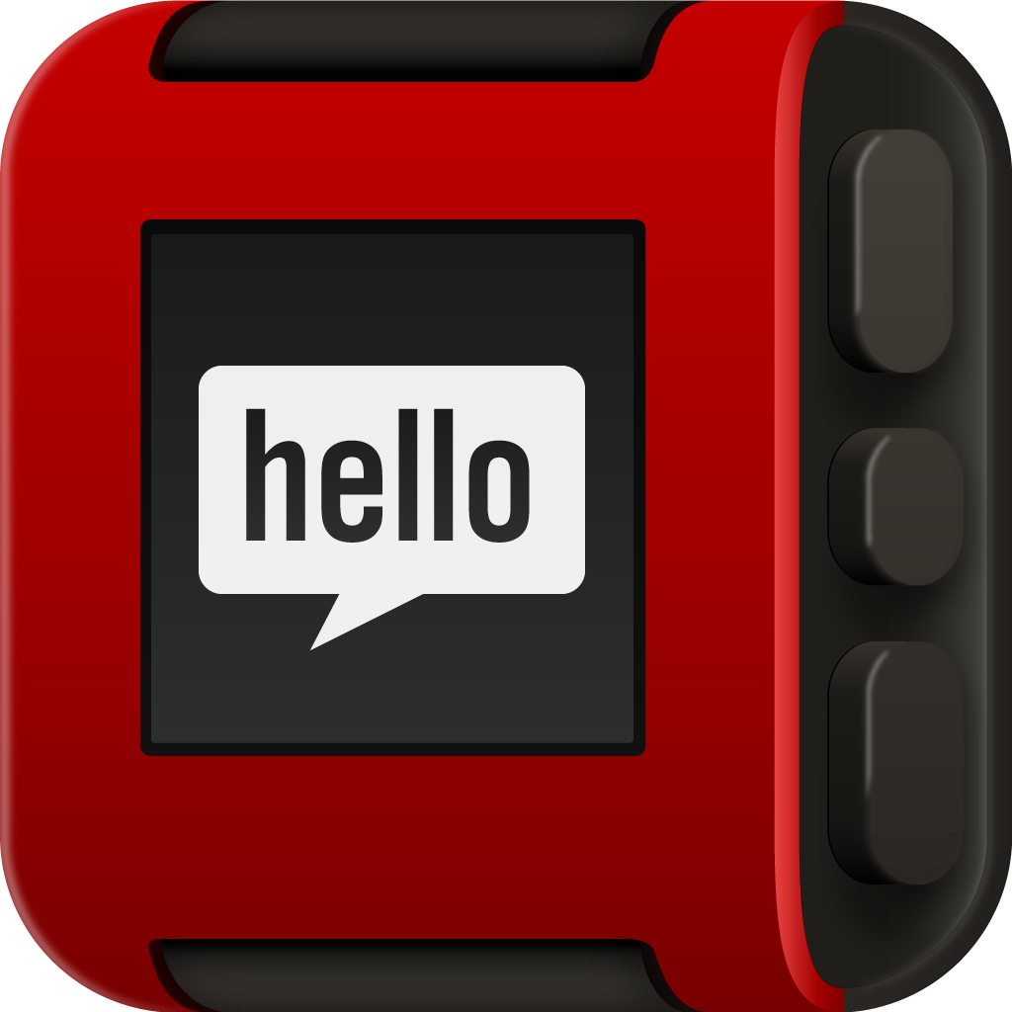







Problem with notifications
Notes:
As we are all familiar that we get notification from an app if it has some new information to share with us. It can be a mail, a call, an offer, a weather alert, a message, a friend request, a tweet, or even a navigation suggestion. So, different apps which are interested for our attention send different notifications in different times. But, it becomes problematic for users when the number becomes huge causing information overload.

Slide 3

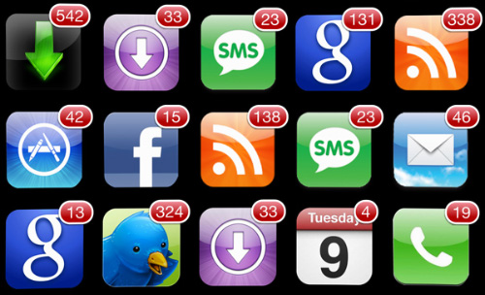
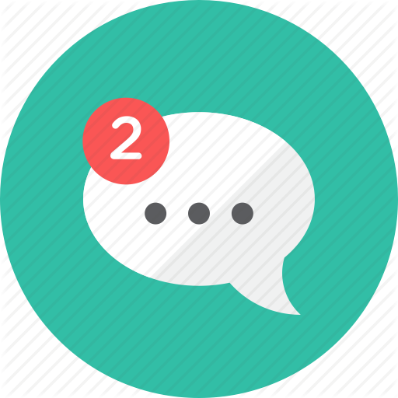
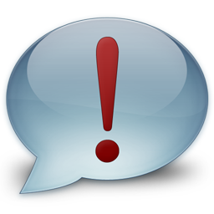

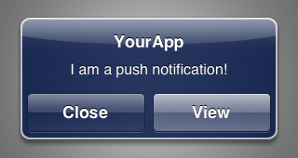

Problem with notifications
Too many
Overwhelming
Information overload
Interrupting at inopportune moments
Disrupting tasks
Interfering lifestyle
Demanding high responsiveness
High attention demand .. (Stress)
Notes:
IN FACT Therefore, there are too many of these notifications are coming and interrupting at inopportune moments which in some cases demand high responsiveness. So, it is overwhelming, disrupting, and require high attention demand which might cause even stress. SO WHAT SHOULD WE DO IDEALLY ?

Slide 4
How to schedule notifications ?
Scheduling important notifications at opportune moments
CHI ‘03
TOCHI ‘05
CHI ’10
TOCHI ‘13
UBICOMP ’14 …
Importance
Interruptibility
Engagement Level
App Launch
Reading
Dismissing
Ignoring
Context …
Notes:
Ideally, what should we do to solve this problem ? There are two main verticals.
However, we focus on the factor which is relatively unexplored in the context of smartphone notifications, as interruptibility is explored heavily. We want to schedule .. And also, we hypothesize that how users respond to different notifications can be a good proxy of importance. And we can predict the attention span from the usage pattern of the user.
Interruptibility has been studies extensively in desktop and mobile .. Assume one engine gives you the interruption points .. Right time to interrupt .. They do not know about the importance of notification ..We want to predict ..
How can one asses the notification importance ? The example ( if a notification is important to user, the user will bother to look at the notif; if its really important, user will launch the corresponding app. In a way, engagement -> reflects importance ..
This is the central point of our paper.
I will show later in this talk ..
We will show later that user attention span is limited .. How to efficiently utilize that for imp notifs.

Slide 5
Remaining Outline
Datasets
Insights gained from the data
Assessing notification importance
Building a notification manager
Conclusion
Notes:
Talk structure : Measure system -> Analysis -> Predict importance

Slide 6
Evaluation datasets
Data Set – I (Notifbase App)
40 users recruited (30 users data > 2 weeks)
App usage, Screen on/off, Wi-Fi status, ringer mode, sound level, notification properties, shade opening, notification action etc.
Android Accessibility service used
Data Set – II (Snotify App)
12 users recruited from the above set
Explicit feedbacks from users for perceived importance (Online survey of 402 users)
Notes:
Data collection. $25 Amazon gift card; UT Austin students (both graduate and undergraduate) and HP researchers. Amazon Mechanical Turk users are recruited $1 per questionnaire basis. We have collected data for 4 weeks. Few users left midway the experiment.
I should point all the recent works which analyze the notification usage they only collect macro level information like notification receiving and deletion time. We looked at all micro interactions to reveal different level of user engagement with notifications. We have used two sets of datasets : first set of dataset to get broader information about notifications and the second set of dataset for getting explicit feedback from users.

Slide 7
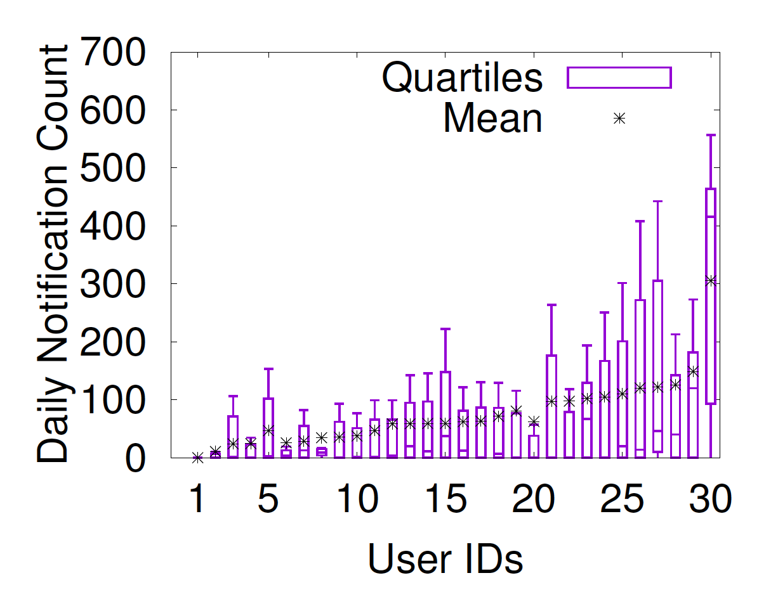
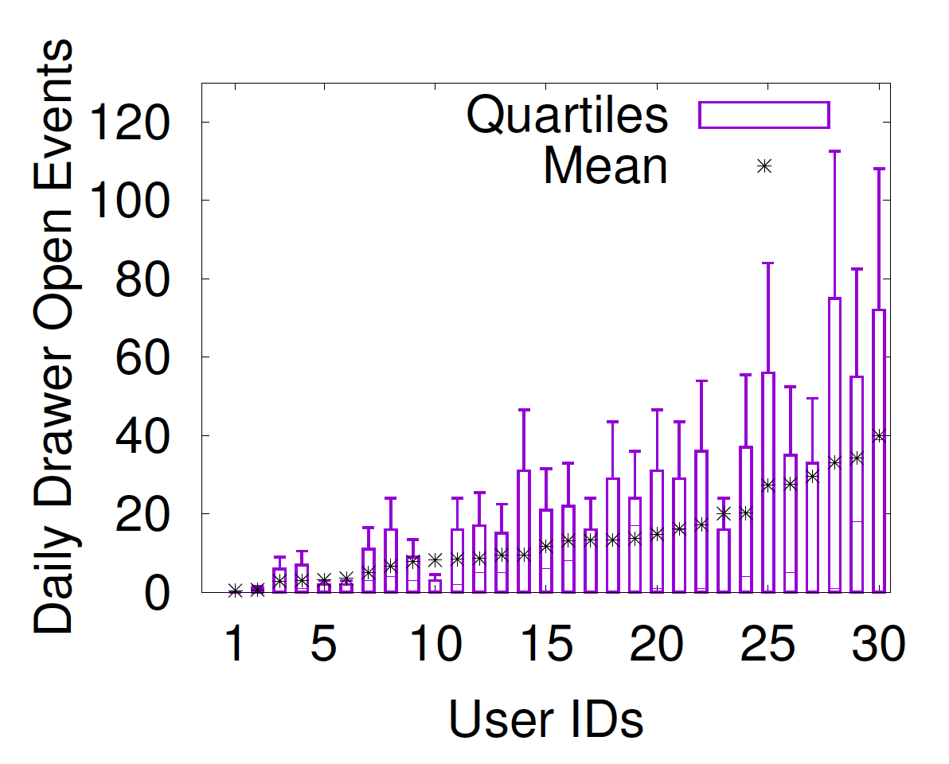
Notifications are disrupting
Receives ~60 notifications/day
Opens notification drawer
~15 times/day
Notes:
Before starting explaining the results, let me explain this box-plot representations. The extremes are min and max, the lower half of the box is the 25th percentile value and upper half is the 75th percentile value, and the start point is the mean value.
Here is also the problem.
In this figure, I am showing for each user on X axis, what is the daily notification count observed. Since, this count varies from day-to-day, we show its distribution using a box plot.
Come and show by choosing 11th one. Max extreme and min extreme ..
2nd graph: Because of the large notifs, users end up checking notifs many times by opening drawer. This is lower bound because lock screen

Slide 8
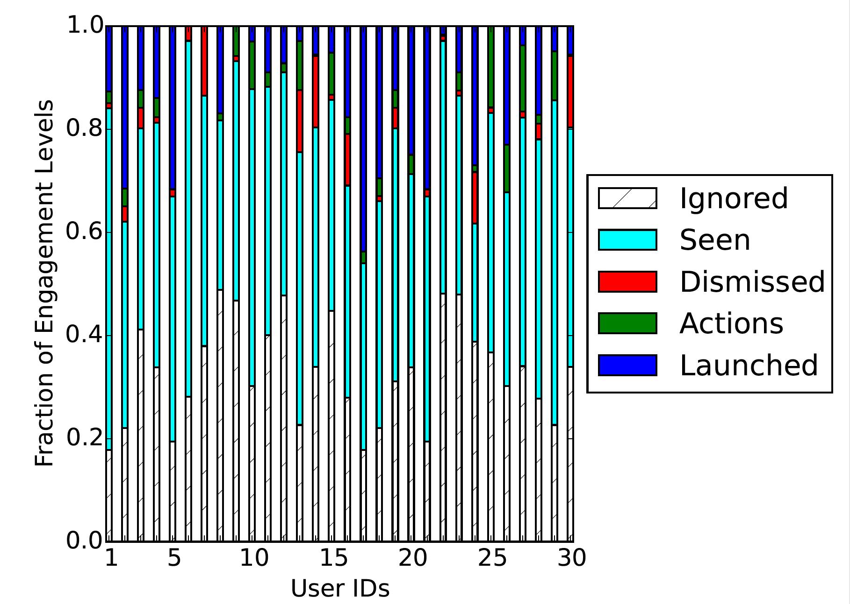
Users ignore most notifications
Users tend to ignore 20-50% of the generated notifications.
Less than 20% of these are causing app launch events.
Notes:
HOWEVER

Slide 9
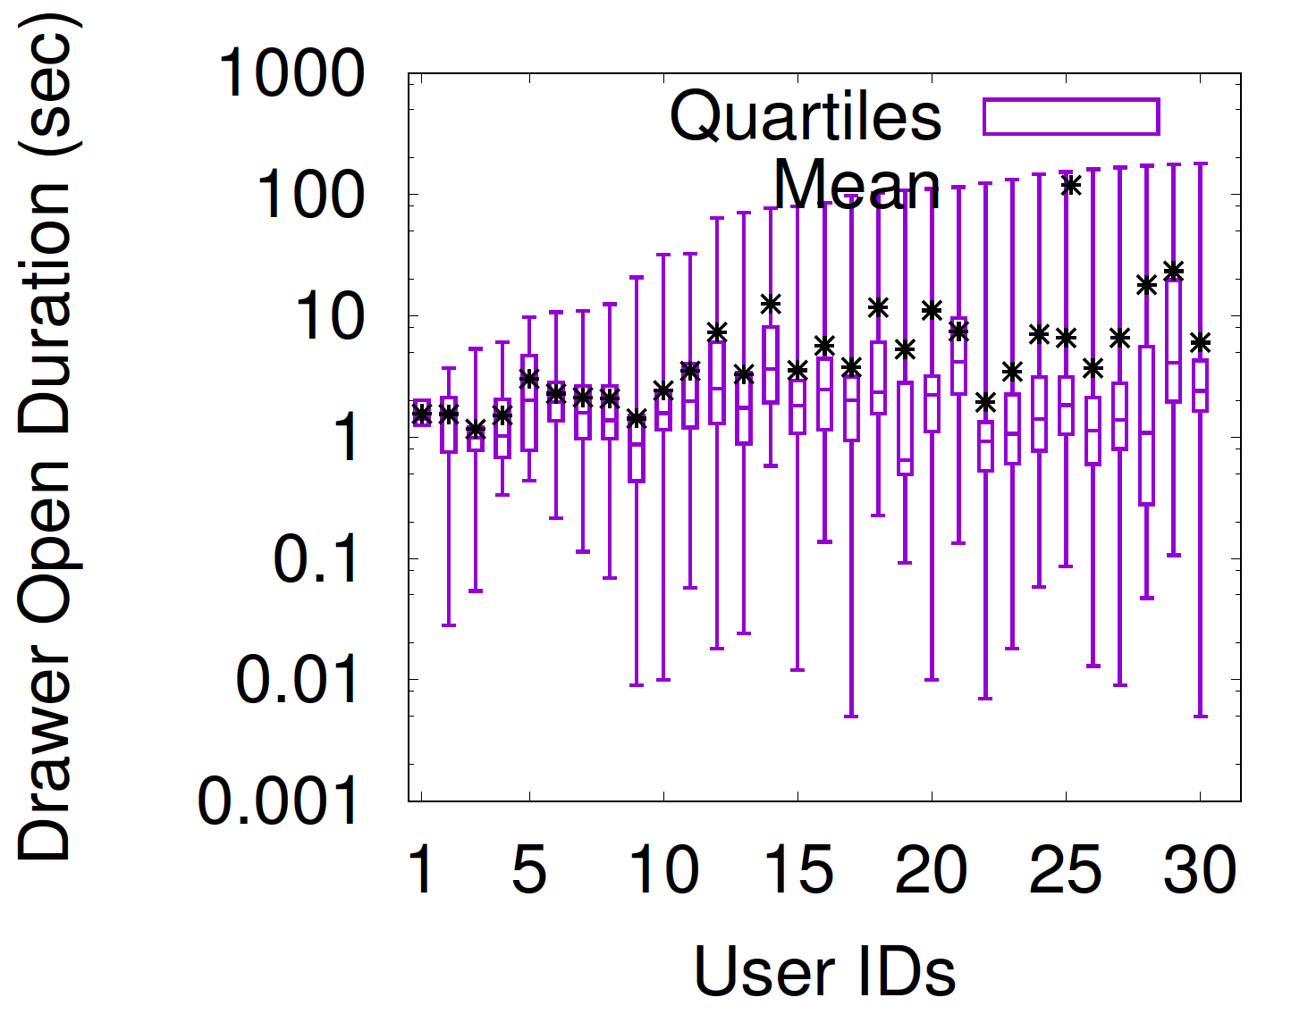
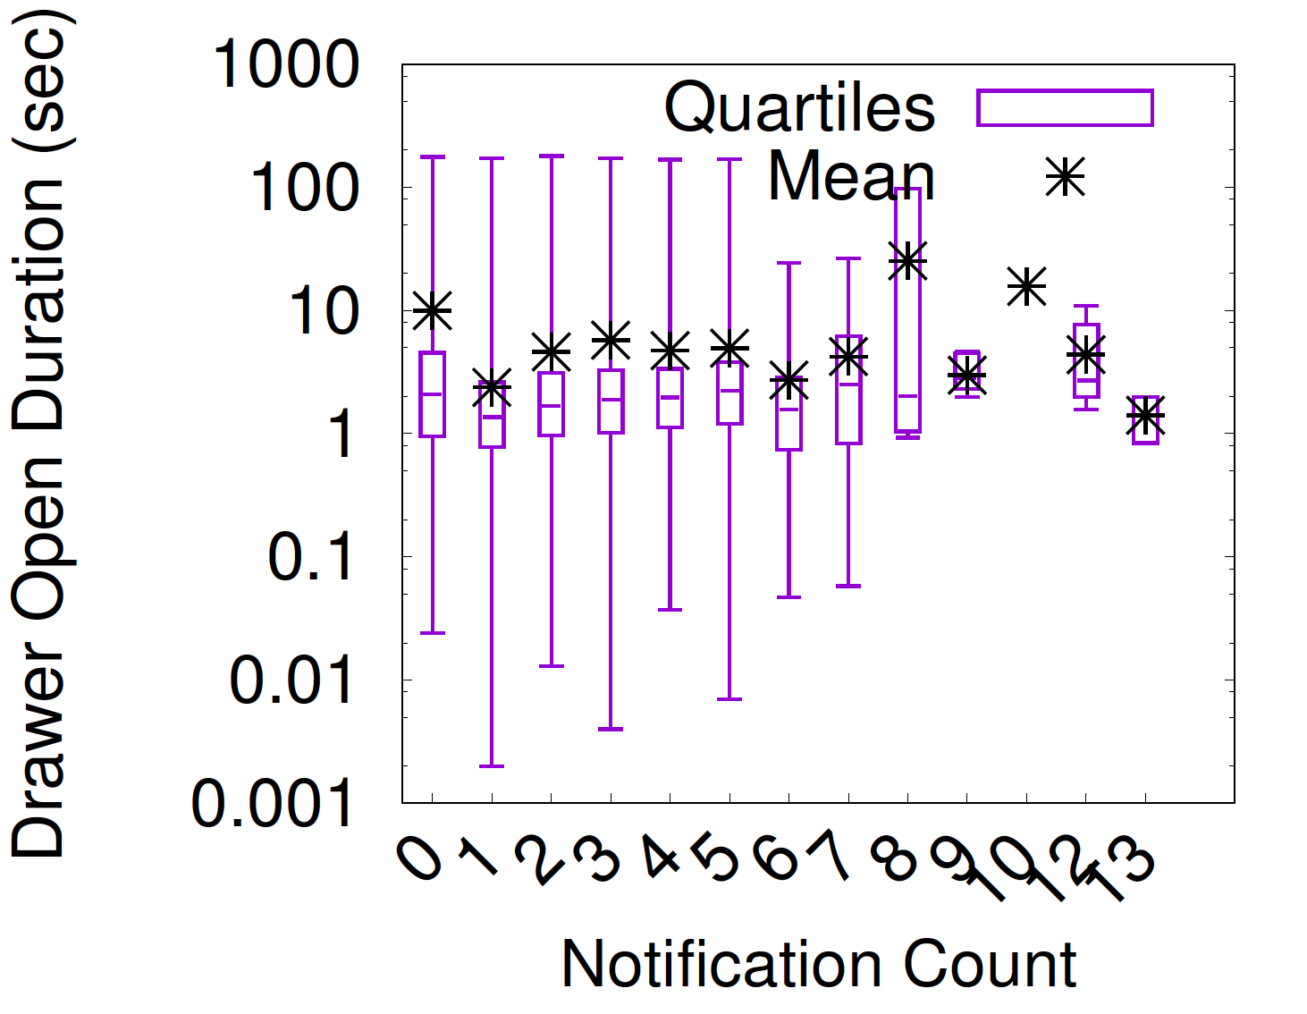
Users have limited attention span
Takes ~1-20 seconds within a
notification drawer session
Attention span does not vary
with number of notifications
Notes:
LIMITED SPAN

Slide 10
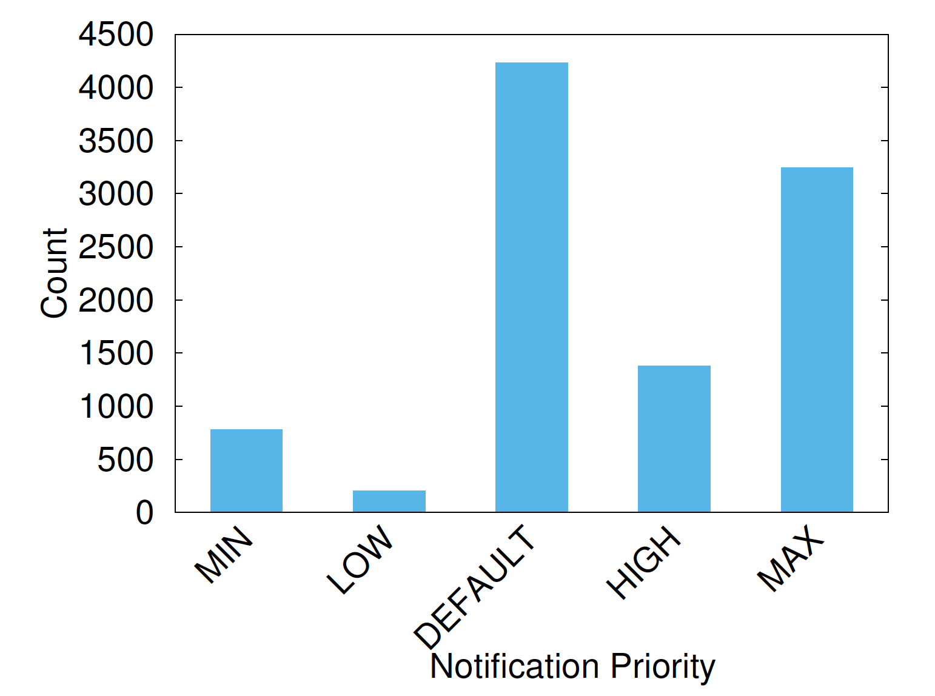
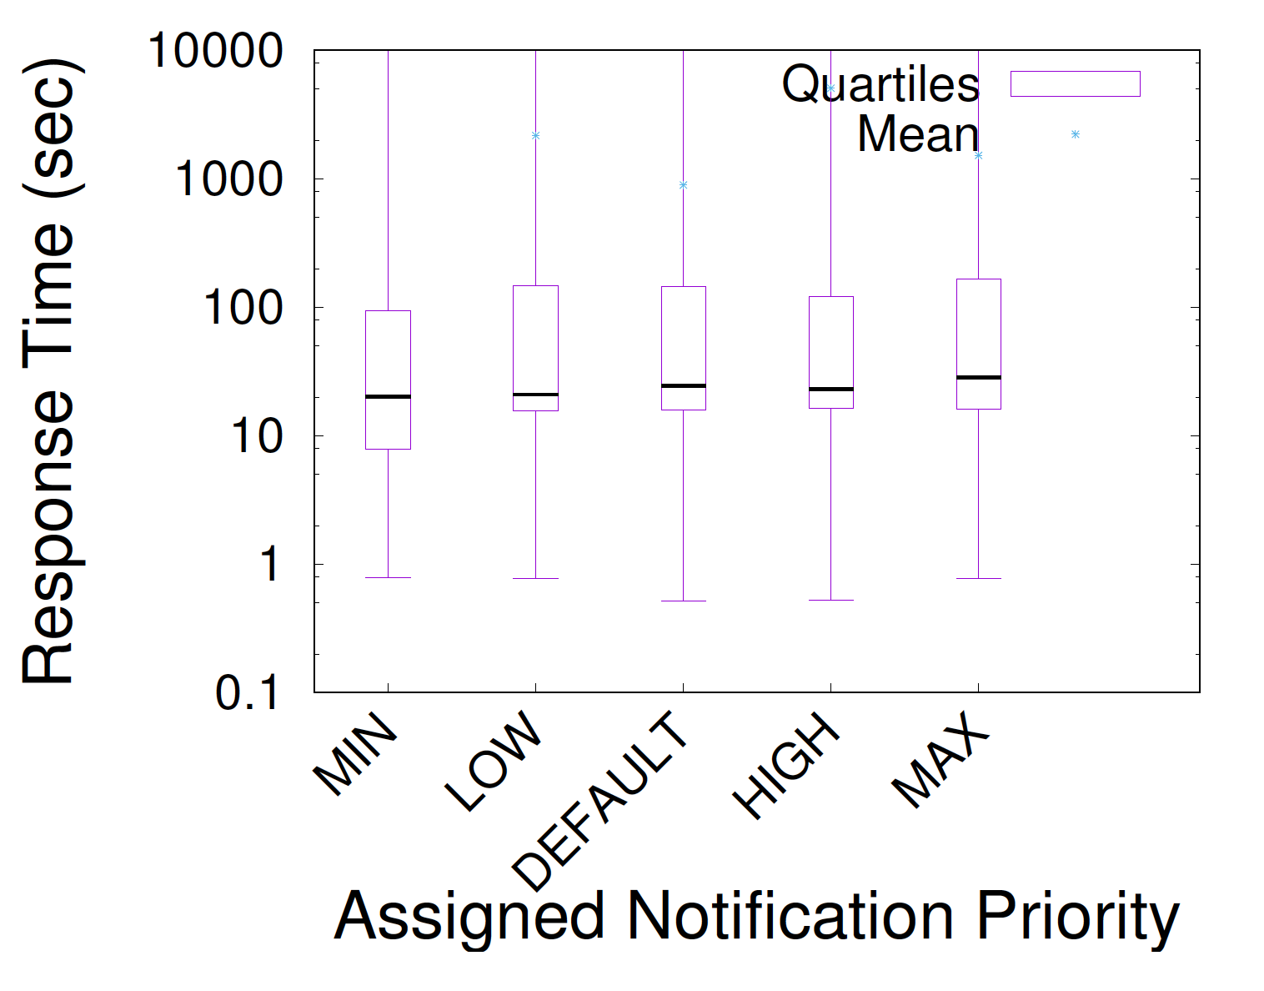
Apps fail to evaluate ‘importance’
Developers assign Default or
High Priority to notifications
Users’ response time almost
constant

Slide 11
Summary of Insights
Users receive large number of notifications
Users take action to prevent disruption
Users ignore most notifications (20%-50%)
Users have limited attention span (~10s)
Apps tend to assign overly high priorities
Correct assessment of notification importance is critical towards removing unwanted notifications and utilizing users’ limited attention span
Notes:
Summary. Therefore, correct assessment of importance may suppress unwanted notifications and better utililzation of attention span.
By correct assessment animation first two points and rest of it presenting fewer notifs, utilize attention span effectively.

Slide 12
Predicting notification importance
Engagement level as an indicator.
Users engage with notifications in several ways :
Ignore
Read (e.g. notification drawer open)
Read and dismiss
Take some action (e.g. “Archive” or “Delete” a mail)
Launch an app
Notes:
As I have already said that, engagement level is a good indicator.

Slide 13
Predicting notification importance
Recent Phone activity
Notification Info
Location
Notification Importance
Engagement history
Surrounding Noise
Binary classification : C4.5 Decision tree, Linear
Regression, Random forest, SVM using 22 features
Notes:
We are just scratching the surface and acknowledge the limitation.

Slide 14
Feature Ranking
Application name of notification
Temporal features related to interaction (e.g. notification post time, clear time etc.)
Hour of the day
Notification title
Ringer mode of the phone
Weekend status
Location cluster etc.
Notes:
Using information gain in decision tree

Slide 15
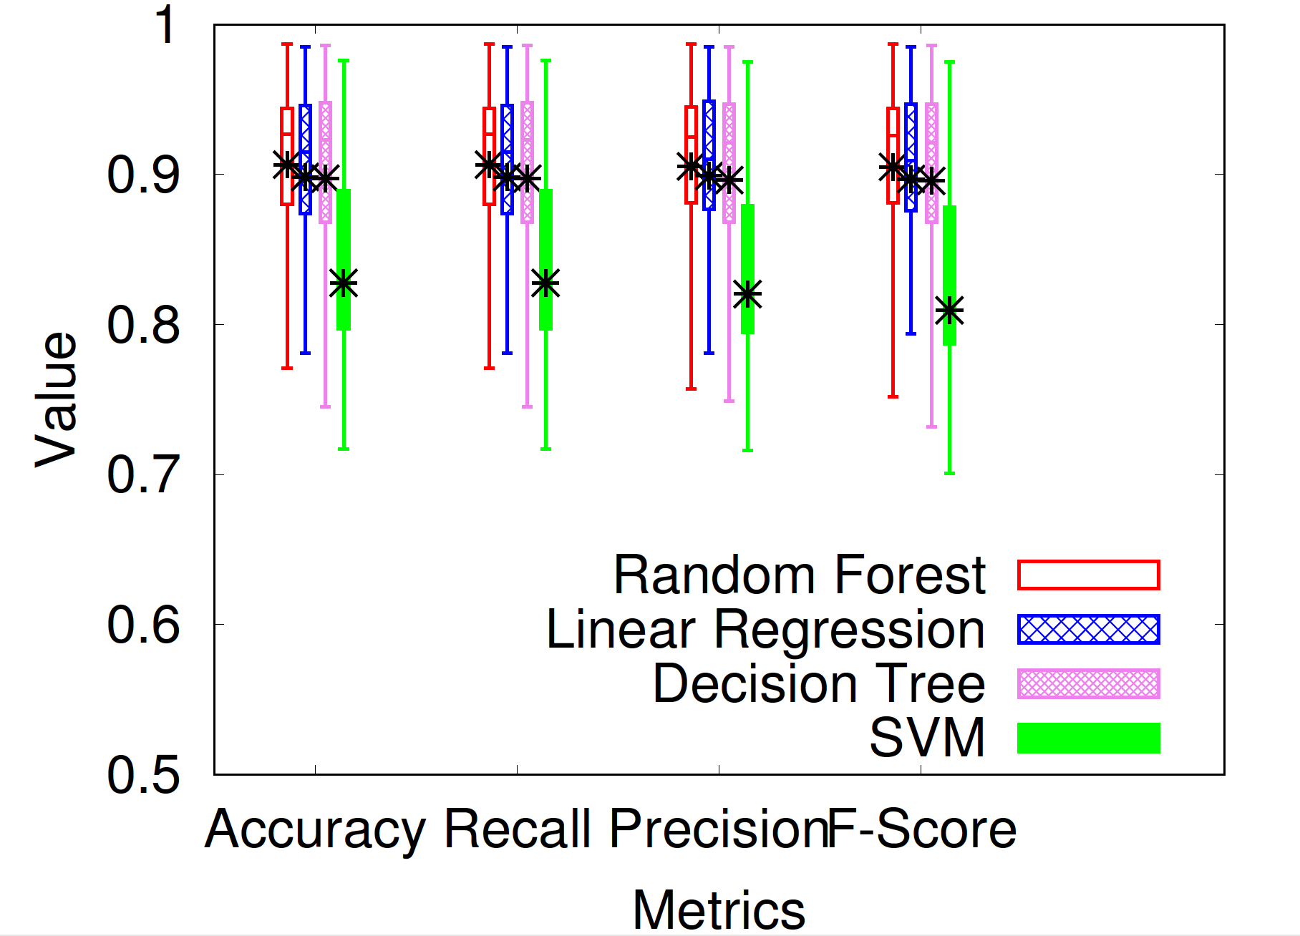
Evaluating a personalized predictor
Results shown on 10-fold cross validation (ground-truth
via explicit feedback) and can achieve ~87% accuracy
Notes:
Problem here in transition.

Slide 16
Generic v Personalized v Clustered
A generic model trained on a subset users’ data and predict the rest.
10-fold cross validation on personal data of each users.
Cluster users based on #applications used, #unique locations visited … Predict within cluster.

Slide 17
Generic v Personalized v Clustered
Clustered model performs better than the personalized model

Slide 18

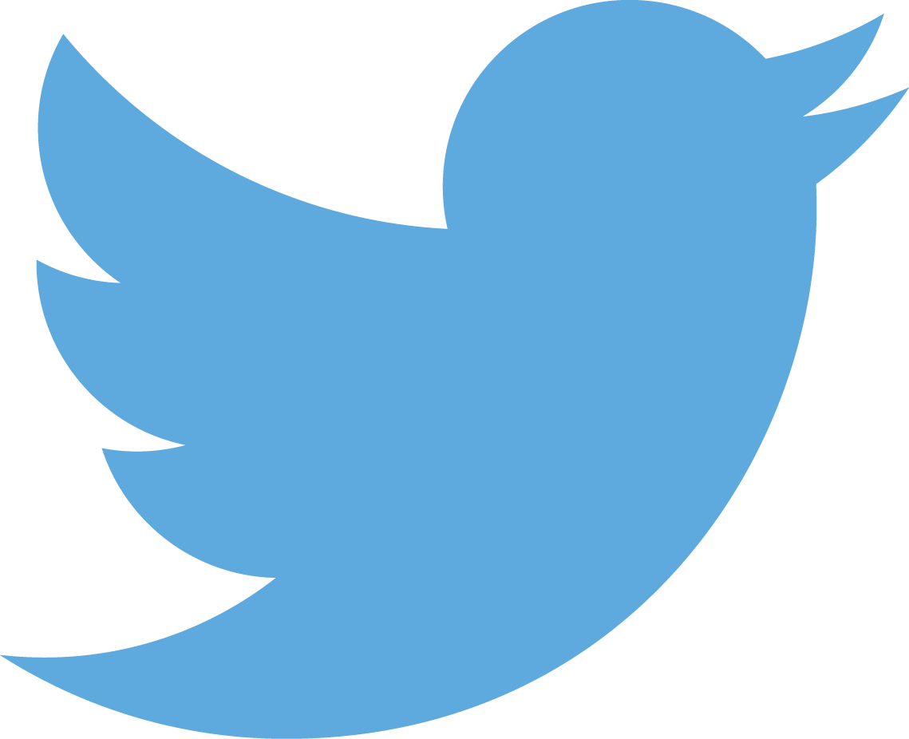
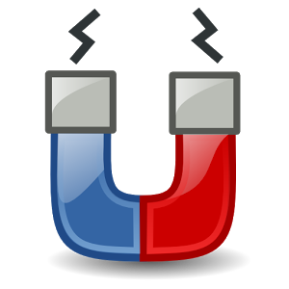
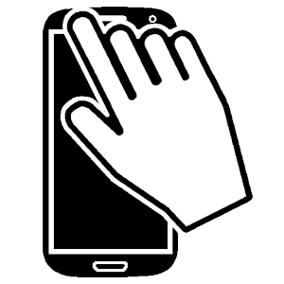






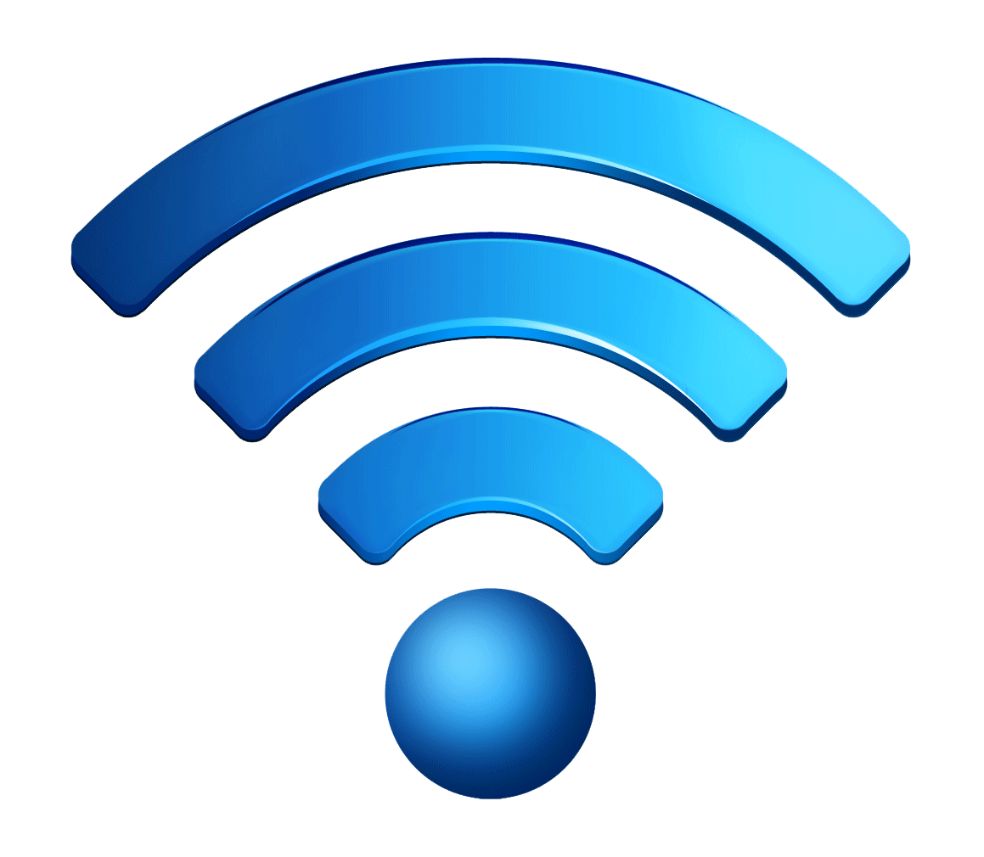






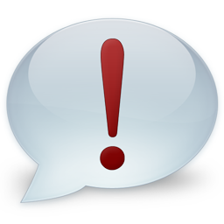


A smarter notification manager
Selected Notifications
Users
Interacts with apps and gives feedback
…
Applications
SmartNotify
Suppressed/Delayed Notifications
Decision Engine
Feature and Engagement Level
Extractor
Model Trainer
Context Monitor
Usage Monitor
Sensors
Time and Location
Audio
Phone Events
App Usage
Notification
Events
Notification
Usage

Slide 19
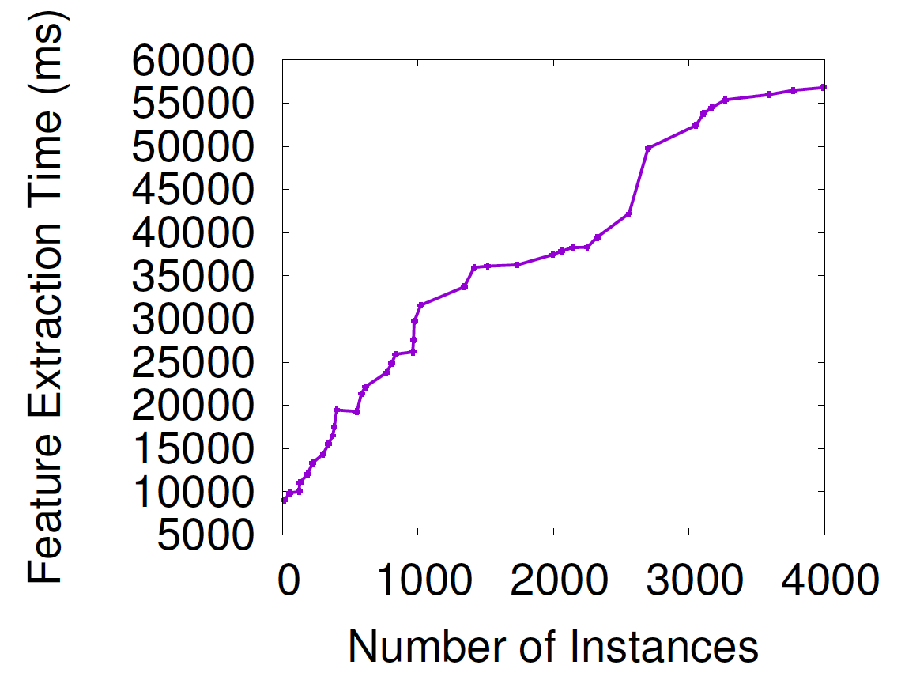
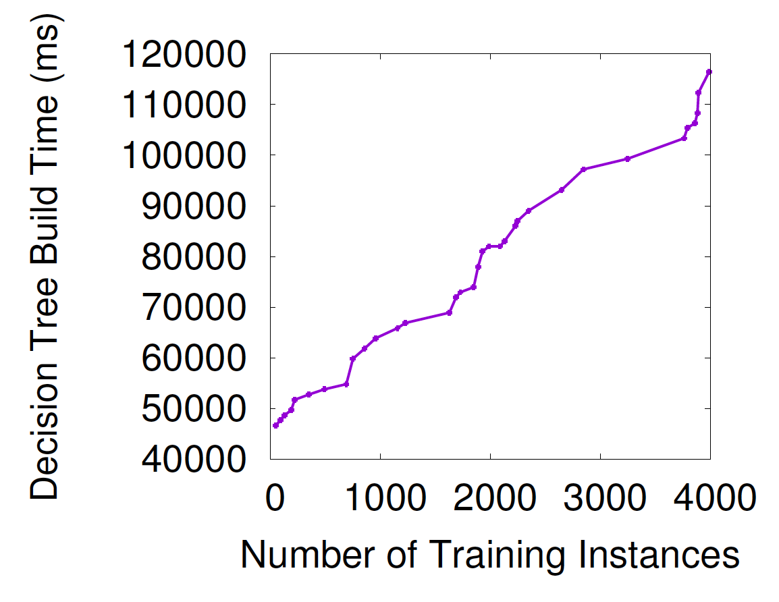
Notification manager performance
Used Weka based C4.5 decision tree for model training and InterruptMe library.
Feature extraction ~10s for and Tree building ~50s for 1000 instances
Notes:
Samsung Galaxy S7

Slide 20
Conclusion
Users are getting disrupted by notifications
Can suppress unwanted notifications if we can predict user’s engagement level
Implemented a smarter notification manager which can predict notification importance with ~87% accuracy

Slide 21
Future works
A first step toward understanding micro user interaction with notification.
Prediction model can be used to decide display order or modality of notifications across multiple devices
Notes:
We have just started scratching the surface.

Slide 22
Thank you & any question ?
Codes for data collector apps:
https://bitbucket.org/swadhinp/notifbase
https://bitbucket.org/swadhinp/snotify
Google Play: https://play.google.com/store/apps/details?id=org.swadhin.app
Notes:
We have just started scratching the surface. A first step toward understanding micro user interaction with notification.
These are the links of the apps used in the paper and we also have a notification tracking app in Google Play. Thank you for your attention. For more details, please read our paper. I am now happy to take any question.

Slide 23
Extra

Slide 24
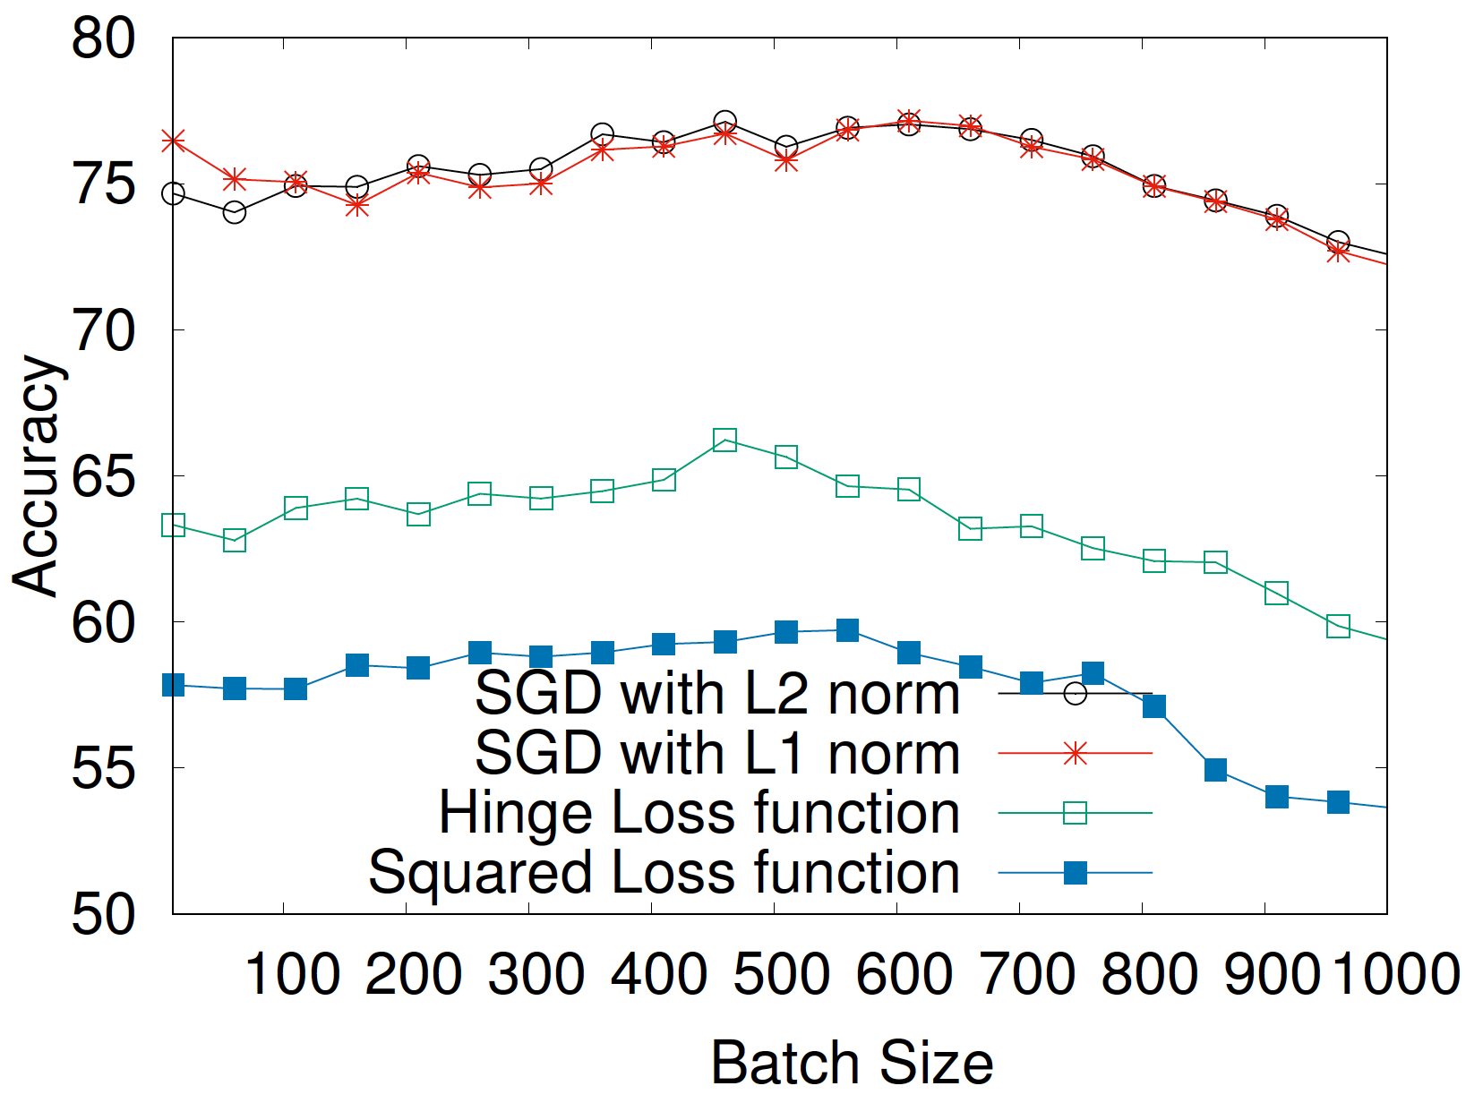
Online learning based prediction
Stochastic Gradient Descent with L2 norm gives best performance and stabilizes with 500 batch size
Notes:
We use vowpal-wabbit tool

Slide 25
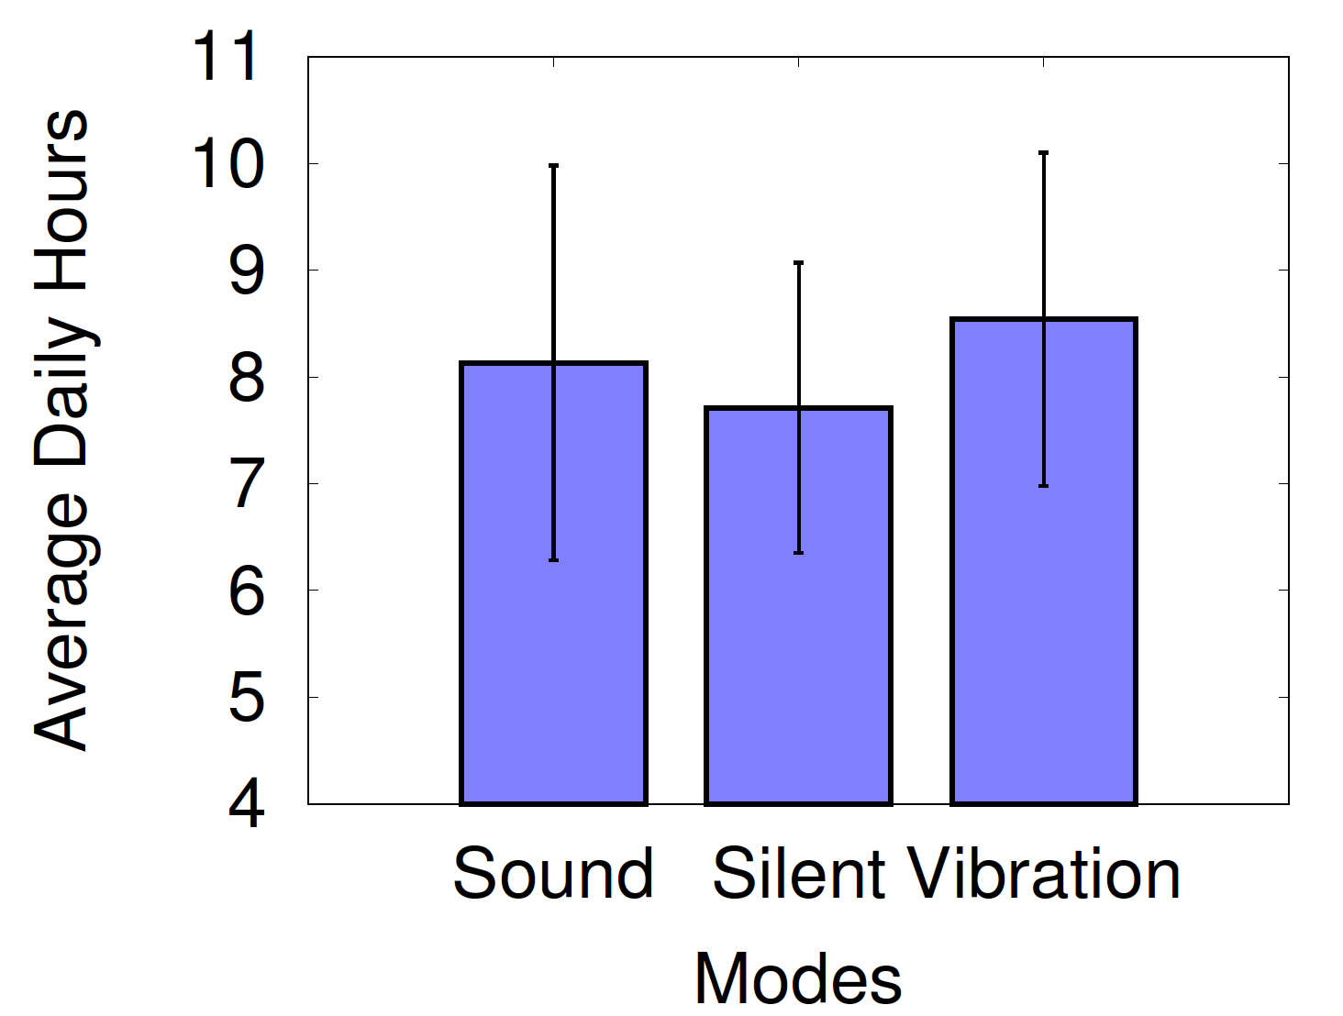
How do users avoid disruptions ?
Setting their
devices
to silent or
vibrating mode
Notes:
Next, we look at how users are responding to these notifications. In some cases, 15 hours.
Remove proxy word.
How do users deal with these disruption ? ( in title)
Answer to this question is : Users set their phones to silent or vibration mode. At least 4 hour to 15 hours ..
We looked at the volume level which is 0 or reasonably low level ..

